Slide 1

Statutory Definition of Wages under Labour Codes

Slide 2

Statutory Definition of 'Wages'
WAGES INCLUDE:
Basic Pay
Dearness Allowance (DA)
Retaining Allowance (if any)
WAGES EXCLUDE:
Statutory bonus
Housing/utilities/amenities
Employer’s PF/pension contributions
Conveyance/travel concessions
Reimbursements, HRA, overtime, commission
Gratuity, retrenchment, ex-gratia

Slide 3
Key Provisions
50% Rule:
• If exclusions (a–i) > 50% of total remuneration, excess is added back to wages.
Equal Wages & Payment:
• Conveyance, HRA, settlement-based pay, and overtime are counted as wages.
Remuneration in Kind:
• Up to 15% of total wages can be in kind and included.

Slide 4

Interpretation & Compliance Notes
Basic + DA must be ≥ 51% of gross wages/CTC.
Allowances must be ≤ 49% of gross wages.
Splitting minimum wages into allowances is not allowed.
Ensures fair statutory contributions (PF, gratuity, etc.)

Slide 5
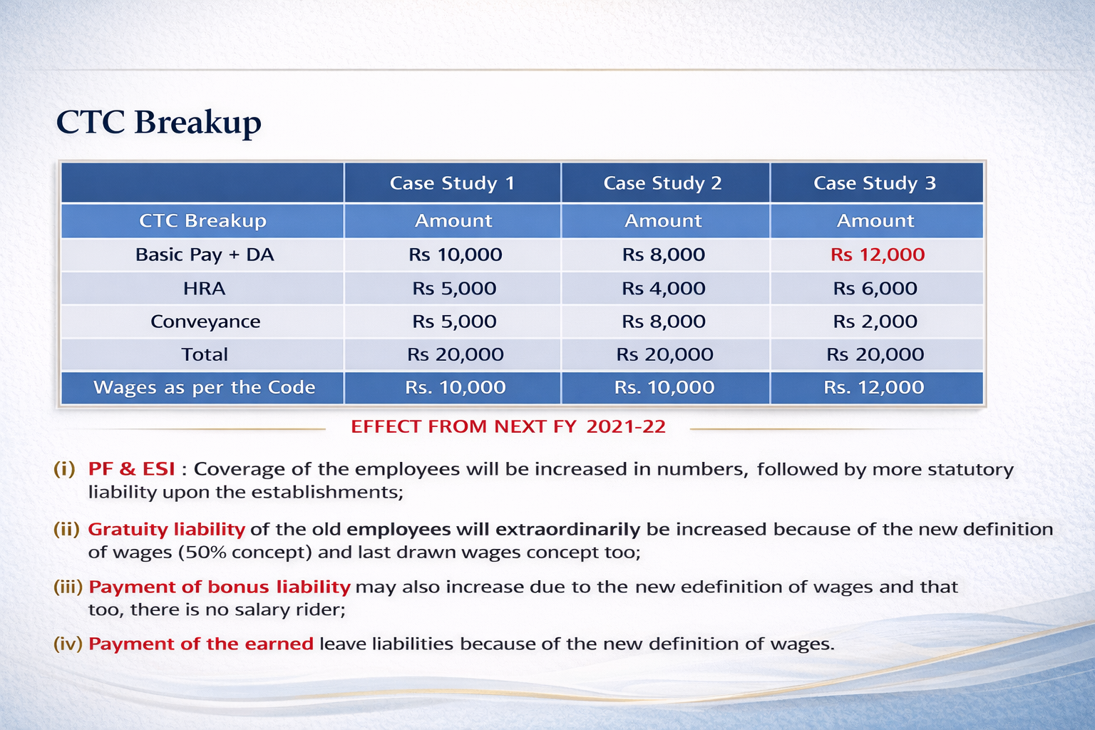

Slide 6

HR Action Plan
(a) Restructure Compensation:
• Redesign wage structures to meet 51:49 ratio.
(b) Assess Financial Impact:
• Reduced take-home pay
• Increased employer contributions
• Higher retirement benefit costs
(c) Prepare for Rollout:
• Effective from April 2021
• Coordinate with finance, payroll, legal, management

Slide 7
Practical Takeaways for HR
Standardized wage definition across all 4 Labour Codes
50% rule prevents allowance inflation
Audit and align wage structures
Educate management on financial implications
Ensure compliance to avoid penalties

Slide 8
Financial Impact of Revised Wage Definition
Effective FY 2025–26, a uniform definition of 'wages' applies across all 4 Labour Codes.
The 50% Rule: If allowances exceed 50% of total remuneration, the excess is added back to 'wages'.
This change significantly increases the statutory wage base and employer liabilities.

Slide 9
1. Increased Social Security Contributions (PF & ESI)
Broader wage base increases number of employees covered under PF & ESI.
Higher employer contributions required.
Employee Benefit Expenses in financial statements will rise.

Slide 10
2. Rise in Gratuity Liability
Gratuity base wage increases due to inclusion of excess allowances.
Long-tenured employees create significant additional liability.
Higher provisioning under 'Long-Term Employee Benefits'.

Slide 11
3. Higher Bonus Liability
No salary ceiling for bonus eligibility under new Codes.
Expanded wage base increases bonus amounts.
Raises 'Short-Term Employee Benefits' provisions.

Slide 12
4. Leave Encashment Liability
Revised wage base increases leave encashment value.
OSH Code mandates compulsory payment of unused earned leave.
Increases 'Leave Encashment Provision' in financials.

Slide 13
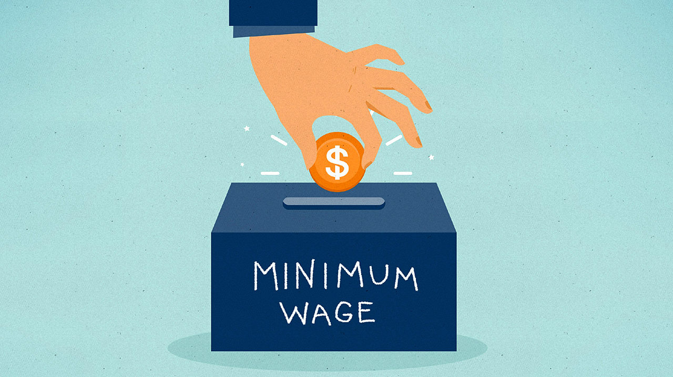
5. No Bifurcation of Minimum Wages
Minimum wages now include only Basic Wage + DA.
No splitting into allowances to reduce liabilities.
Raises compliance cost for contract labour and outsourcing.

Slide 14
6. Aggregator Contributions for Gig Workers
Applicable to Ola, Uber, Amazon, Flipkart, Swiggy, Zomato, etc.
Must contribute 1–2% of turnover or 5% of gig worker payouts (whichever is lower).
Creates new statutory cost head for platform businesses.

Slide 15
7. Impact on CTC Model
Current CTC models inflate allowances to reduce liabilities.
New rule mandates Basic + DA ≥ 50% of total remuneration.
Results in lower take-home pay and higher employer contributions.
Increases 'Salary & Wages' provisioning in financials.

Slide 16
8. Overall Financial Impact Summary
Higher PF, ESI, gratuity, bonus, and leave encashment liabilities.
No allowance-based wage structuring to bypass obligations.
New gig worker contributions for aggregators.
Major shift in CTC structures across industries.
Substantial rise in employee-related expenses and compliance costs.

Slide 17

Contact No: 9425076193

