Slide 1



DECODING THE NEW LABOUR CODES
GIRISH PATWARDHAN
(SENIOR ADVOCATE)

Slide 2


THE INDUSTRIAL RELATIONS CODE
The Industrial Disputes Act 1947
The Trade Unions Act 1926
The Industrial Employment
(Standing Orders) 1926
PATWARDHAN LAW ASSOCIATES

Slide 3

KEY HIGHLIGHTS
Amalgamation of 3 Acts:
  Direct impact on Employer-Employee relations,
  Industrial Peace, Harmony & Discipline.
Major Changes:
  Definitions – updated for clarity and scope
  Adjudicatory Authorities – revised composition Execution
  Process – streamlined and simplified
PATWARDHAN LAW ASSOCIATES

Slide 4
PHASES OF THE
INDUSTRIAL RELATIONS ACT
Former PM Rajiv Gandhi Era (1980s)
  Initial idea of a comprehensive Industrial Relations
  Act was conceived. First attempt to streamline multiple labour laws into a unified framework.
Bill Introduced in Parliament
  A draft Industrial Relations Bill was formally placed before Parliament.Subsequently, the Bill was referred to the Standing Committee for detailed examination.
PATWARDHAN LAW ASSOCIATES

Slide 5
PHASES OF THE
INDUSTRIAL RELATIONS ACT
Post Committee Developments
  Recommendations and critiques led to multiple revisions. Consensus building continued among stakeholders (workers, employers, government).
2014 Onwards
  Government revived discussions on a single, nationwide Industrial Relations legislation.
  Aim: Replace outdated laws and ensure uniform applicability across all Indian States.Triggered the process that eventually culminated in the Industrial Relations Code, 2020.
PATWARDHAN LAW ASSOCIATES

Slide 6
DEFINITIONS HAVING MAJOR CHANGES
  INDUSTRY,
  INDUSTRIAL DISPUTE,
  FIXED TERM EMPLOYMENT,
  RETRENCHMENT,
  WORKER,
  WAGES,
  STRIKE, AND
  STRIKE AND LOCKOUT.
PATWARDHAN LAW ASSOCIATES

Slide 7
CLAUSE 2(P) – “INDUSTRY”
“Industry" means :
  any systematic activity ,
  carried on by co-operation between an employer and worker (employed directly or through any agency including a contractor) ,
  for the production, supply or distribution of goods or services with a view to satisfy human wants or wishes – not being spiritual or religious in nature ,
whether or not,
(i) any capital has been invested for the purpose of carrying on such activity; or
(ii) such activity is carried on with a motive to make any gain or profit. However the definition excludes – Institutions owned or engaged in • Charitable, Social, or philanthropic service,
  Domestic service and any other activity notified by the Central Government.
PATWARDHAN LAW ASSOCIATES

Slide 8

CLAUSE 2(Q) – “INDUSTRIAL DISPUTE”
Includes individual dispute and collective disputes.
PATWARDHAN LAW ASSOCIATES

Slide 9
CLAUSE 2(O) - “FIXED TERM EMPLOYMENT”
Providing for engagement for a fixed period but ensuring hours of work, wages, allowances and other benefits not less than that of a permanent workman doing same or similar work. Also eligible for proportionate statutory benefits without applying qualifying period of employment required in the statute and gratuity if he renders service for a period of one year. (For us in M.P., it is not new.)
PATWARDHAN LAW ASSOCIATES

Slide 10

CLAUSE 2(ZH) – “RETRENCHMENT”
Excludes termination on completion of tenure of fixed term employment.
PATWARDHAN LAW ASSOCIATES

Slide 11
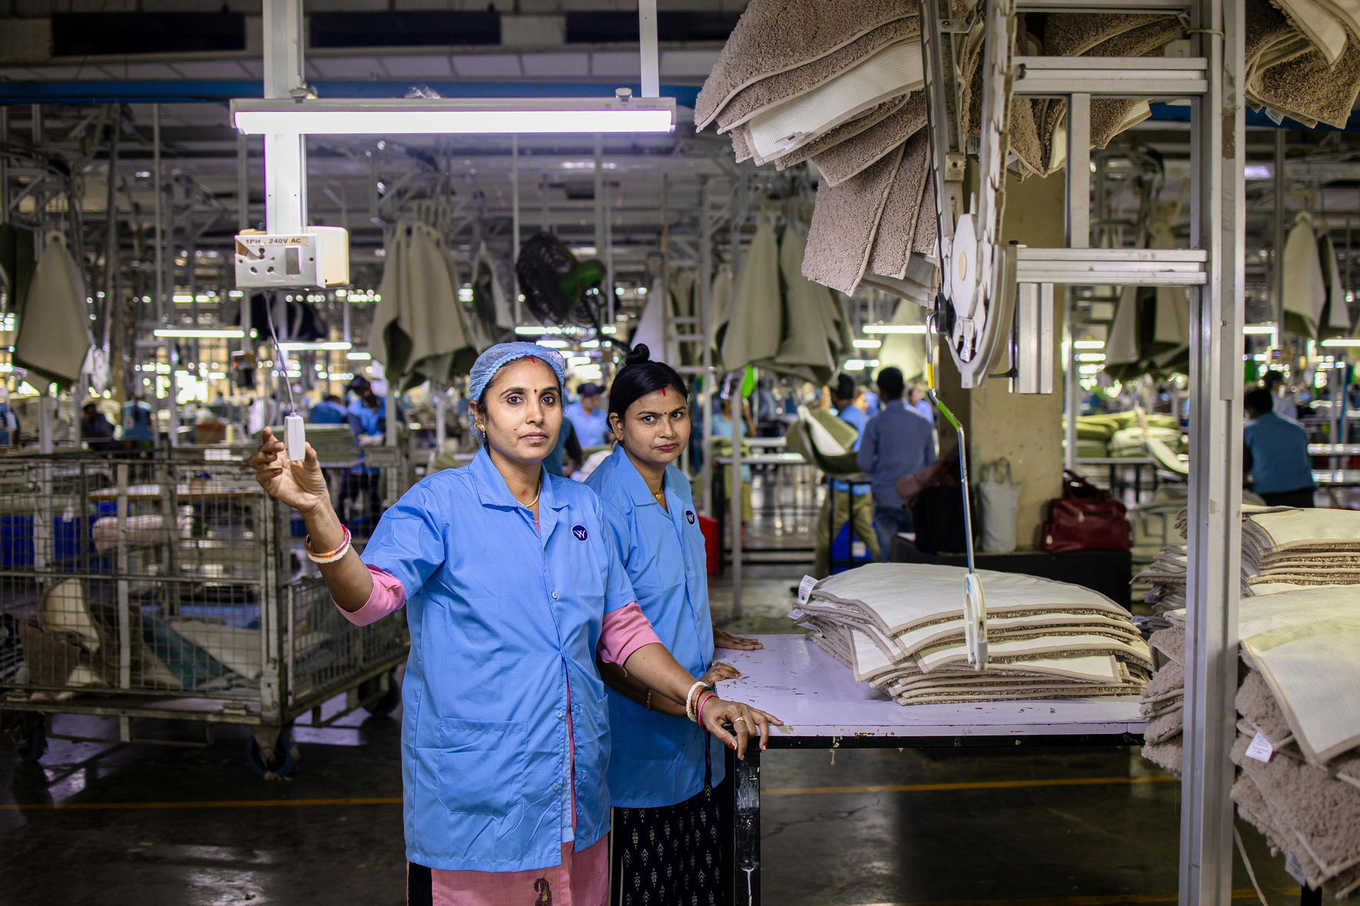
CLAUSE 2(ZR) –“WORKER”
Excludes Apprentice as defined under Clause 2(aa) of Apprentice Act, Includes Working journalists and Sales Promotion employees But excludes person employed mainly in a managerial or administrative capacity or who is employed in supervisory capacity drawing wage of exceeding Rs.18,000/- per month or an amount notified by the Central Government from time to time.
PATWARDHAN LAW ASSOCIATES

Slide 12
CLAUSE 2(ZQ) – “WAGES”
Includes only basic pay, dearness allowance and retaining allowance. Excludes various allowances provided it does not exceed one-half or such other percent as notified by the central government. The amounts which exceed one-half or the percent so notified is deemed to be a remuneration.
PATWARDHAN LAW ASSOCIATES

Slide 13

CLAUSE 2(ZK) -“STRIKE”
Includes concerted casual leave on a given day by fifty per cent or more workers employed in an industry. Go slow has been added in Unfair Labour Practice
PATWARDHAN LAW ASSOCIATES

Slide 14
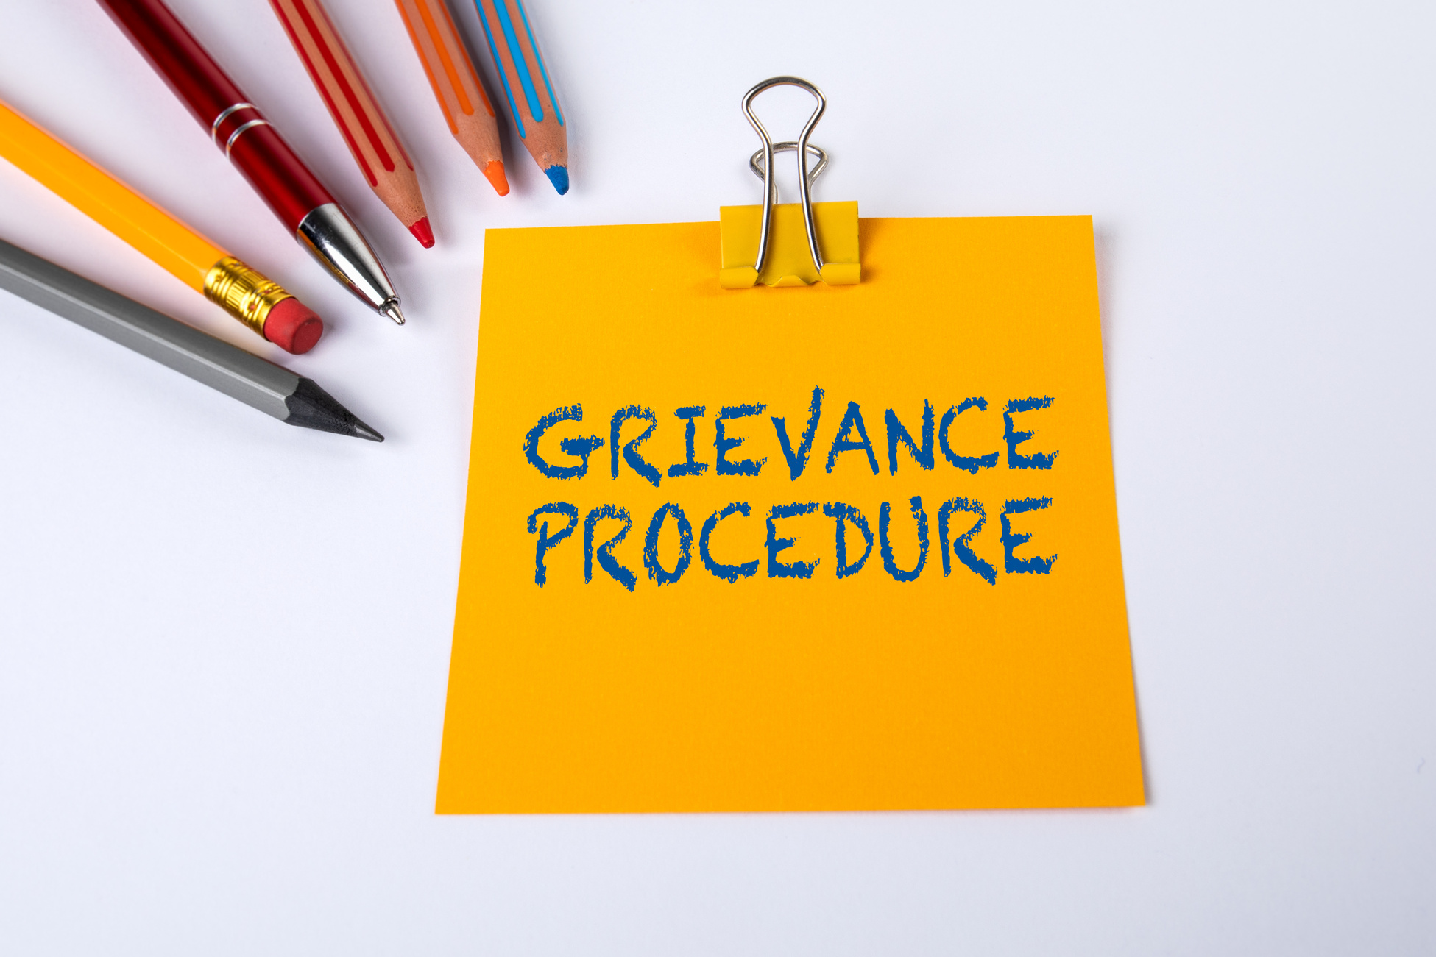
S4 - GRIEVANCE REDRESSAL COMMITTEE
  Works with majority opinion and proceeding is concluded in 30 days.
  In case if any dispute is not resolved, workers may approach conciliation officer through Union
  Chairperson of GRC shall be from employer & employee on rotational basis
  Total no. 10 with adequate representation of Women
  Employer and workers should be equally represented.
  Industrial establishment having 20 or more employees
PATWARDHAN LAW ASSOCIATES

Slide 15
WORKS COMMITTEE AND REDRESSAL OF GRIEVANCES COMMITTEE
REDRESSAL OF GRIEVANCES COMMITTEE
WORKS COMMITTEE
  Grievances Committee is to be constituted for Industrial Establishments employing 20 or more
  Will have equal number of members of employer and employee,
  Chairperson of GRC will be from employer and workmen on rotation basis every year,
  Equal Member from Management and Workers will form the Work Committee if 100 or more workers are employed in the plant.
  Erstwhile Section 3 of Industrial Dispute Act, 1947
PATWARDHAN LAW ASSOCIATES

Slide 16
WORKS COMMITTEE AND REDRESSAL OF GRIEVANCES COMMITTEE
REDRESSAL OF GRIEVANCES COMMITTEE
  Maximum number of GRC will be 10,
  Proportionate representation of Work Women in GRC,
  Repealed Section 9-C, Section 2-A of Industrial Dispute Act, 1947
PATWARDHAN LAW ASSOCIATES

Slide 17
WORKS COMMITTEE AND REDRESSAL OF GRIEVANCES COMMITTEE
REDRESSAL OF GRIEVANCES COMMITTEE
  An application by aggrieved worker can be submitted within one year from accrual of cause of action,
  GRC will decide a case within 30 days,
  Decision of GRC shall be on majority view provided, more than half of worker members agree to such decision,
  Worker aggrieved by GRC decision may approach Conciliation Officer within 60 days.
PATWARDHAN LAW ASSOCIATES

Slide 18
WORKS COMMITTEE AND REDRESSAL OF GRIEVANCES COMMITTEE
REDRESSAL OF GRIEVANCES COMMITTEE
  Section 4 (9) Code is in fact Section 2A of ID Act,
  Section 4(10) is in fact Section 2A of ID Act,
  An application under 4 (10) has to be submitted to the Tribunal within 2 years,
PATWARDHAN LAW ASSOCIATES

Slide 19
REGISTRATION OF A TRADE UNION
7 or more members may apply for trade union
Industry establishment must have at least 10% or 100 workers, whichever is less
Union at anytime shall not have less than prescribed number of workers.
PATWARDHAN LAW ASSOCIATES

Slide 20
ELEMENTS OF CONSTITUTION OF TRADE UNION
  Name of the Trade Union.
  Object
  Procedure of Administration
  Purpose
  Dissolution of Union
  Amendment
  Procedure of elections of executive members
  Conditions for entitlement of benefits and foretiture
PATWARDHAN LAW ASSOCIATES

Slide 21
S.14 -
RECOGNITION
  If only one union is operating, then employer will recognize it as Sole Negotiating Union
  Minimum Period 3 years and maximum 5 years
  In case of multiple Unions, Union with 51% membership shall be recognize as Sole Negotiating Union by employer
PATWARDHAN LAW ASSOCIATES

Slide 22
NEGOTIATING COUNCIL
  When none of the unions has 51% membership, a negotiation council is constituted by employer, which must have more than 20% of support.
  Negotiating Council shall sign a settlement agreement.
  Intra Union dispute will be decided by Industrial Tribunal.
PATWARDHAN LAW ASSOCIATES

Slide 23
ELIGIBILITY & POLITICAL NEUTRALITY FOR TRADE UNION OFFICE
Political Neutrality:
No Minister or person holding office of profit can become office bearer
Minimum Age:
18 years to be a member of a trade union.
Membership:
Only employees of the establishment can be members.
A person convicted for moral turpitude & sentenced for imprisonment can become office bearer only after 5 years from the date of release.
PATWARDHAN LAW ASSOCIATES

Slide 24
MODEL STANDING ORDERS (SECTION 28 TO 39)
  This provision shall apply on establishment having 300 or more workers
  Government may prescribe Industry-wise Model Orders
  Submission: Draft to be submitted within 6 months; consult Trade / Negotiating Union
  The Industries which do not have 300 or more workers, will continue to be governed by the Standing Orders which were applicable to them prior to commencement of this Code,
PATWARDHAN LAW ASSOCIATES

Slide 25
MODEL STANDING ORDERS (SECTION 28 TO 39)
  The Government will notify Model Standing Orders u/s 29 and any establishment may submit their draft Standing Orders within 6 months from the date of commencement of Code to the Certifying Officer,
  The Employer shall consult Negotiating Union or Negotiating Council in respect of draft of Standing Orders,
  The Certifying Officer will issue notice in absence of Union to representatives of workers,
PATWARDHAN LAW ASSOCIATES

Slide 26
MODEL STANDING ORDERS (SECTION 28 TO 39)
  If Certifying Officer does not complete or fails to complete procedure for certification within 60 days from the date of receipt of the it, the modification shall be deemed to be certified,
  S-86 (10) govern the penalty provision ofSubmission of Draft Standing orders (on crossing 300 workmen) or altering Certified Standing orders without authorization Rs. 50,000/- to 2,00,000/- for the first time and Rs. 2,000/- per day if continuing offence, till it is cleared.
PATWARDHAN LAW ASSOCIATES

Slide 27
MODEL STANDING ORDERS (SECTION 28 TO 39)
  Unauthorised submission/alteration of draft/certified Standing Orders: ₹50,000–2,00,000 first time.
  Continuing offence: ₹2,000 per day until compliance.
PATWARDHAN LAW ASSOCIATES

Slide 28
CERTIFYING OFFICER AND APPELLATE AUTHORITY
They shall have powers of Civil Court, in following matters:
  Receiving evidence
  Administering Oath
  Attendance of Witness
  Production of Documents
  An Appeal can be Filed within 60 days to the respective appellate authority
  Any order passed by Appellate Authority can be challenged in High Court
PATWARDHAN LAW ASSOCIATES

Slide 29
NOTICE OF CHANGE (SECTION 40)
Background: Repeats Section 9-A, ID Act & Section 31, MPIR Act
It states-
  Notice of Change – Section 40 (IR Code 2020)
  No employer shall effect any change in conditions of service without giving notice to the affected workers.
  Change cannot be effected within 21 days of giving notice.
  Change can be enforced only after 21 days from notice.
40(2) of the IR Code provides exceptions to the usual 21-day notice requirement.
Normal notice is waived insettlements, awards, emergencies, or government-directed changes
PATWARDHAN LAW ASSOCIATES

Slide 30
VOLUNTARY REFERENCE OF DISPUTE TO ARBITRATION (SECTION 63)
Repeats: Section 10-A, ID Act 1947
  Written Agreement: Workers & employer can refer disputes to arbitration
  Arbitrators: Tie resolved by umpire, award final
  Formality: Copy sent to Government & Conciliation Officer
Representation:
  General disputes → Union/Council/worker representative
  Termination disputes → Worker/self or authorized representative
  Award Submission: Arbitrator(s) submit to Appropriate Government
  Strike/Lockout: Can be prohibited during arbitration
  Exemption: Arbitration Act, 1996 does not apply
PATWARDHAN LAW ASSOCIATES

Slide 31
RESOLUTION OF INDUSTRIAL DISPUTE
Labour Courts Abolished: All pending cases transferred to Industrial Tribunal
Administrative Member: Rank not below Joint Secretary
Judicial Member: HC Judge or eligible for HC Judge, or ≥10 years as Judicial Officer (Section 184, Finance Act 2017)
Tribunal Composition: 2 members – Judicial & Administrative
PATWARDHAN LAW ASSOCIATES

Slide 32
INDUSTRIAL TRIBUNAL GLANCE OVER SECTIONS 49–58
  Section 49: Tribunal composition –
  Two-member Tribunal: discharge/dismissal, strike/lockout, retrenchment & closure, trade union disputes, interpretation of Standing Orders
  One-member Tribunal: other disputes
  Sections 50–52: Tribunal powers – interim relief, evidence, hearings, decision-making
  Sections 53–58: Adjudication – settlements, awards, binding effect, and enforcement
  Major Change: Labour Courts abolished; pending cases transferred to Industrial Tribunals
  Government defines composition, powers, and qualifications of Tribunal members.
PATWARDHAN LAW ASSOCIATES

Slide 33
REPRESENTATION IN DISPUTE PROCEEDINGS SECTION 94
Workers: Can be represented by:
  Executive/member of their registered Trade Union
  Executive/member of a federation of Trade Unions
  If not a member of any union, by other authorised worker representatives
Employers: Can be represented by:
  Officer of an employer association
  Officer of a federation of employer associations
  If not a member, by other authorised employer representatives
  Legal Practitioner:
  Not allowed in conciliation or Tribunal proceedings unless consented by all parties and permitted by Tribunal
PATWARDHAN LAW ASSOCIATES

Slide 34
SECTION 96 – POWER OF APPROPRIATE GOVERNMENT TO EXEMPT
  Conditionally or unconditionally exempt any establishment/class from certain provisions of the Code if adequate provisions exist to meet objectives.
  For new establishments, exemption can be granted for a specified period in public interest.
  State notifications under ID Act, 1947 remain valid until their expiry.
PATWARDHAN LAW ASSOCIATES

Slide 35
FOLLOWING DISPUTES WILL BE HEARD BY TWO MEMBER OF INDUSTRIAL TRIBUNAL
  Dispute regarding Legality of discharge or dismissal,
  Legality of Strike or Lockout,
  Legality of Retrenchment and closure,
  Trade Union Dispute, and
  Interpretation of Standing Orders,
  Other disputes can be decided by 1 Member Tribunal
PATWARDHAN LAW ASSOCIATES

Slide 36
  Section 50(2) : Court can grant Interim Relief to the worker.
  No Industrial Dispute can be ceased in Conciliation after 2 years.
  Section 53(3) is replacement of Section 12 (3) of ID Act.
  Section 53(4) is replacement of Section 12 (4) of ID Act.
  A measure change is brought about power of Government to refer a dispute has been taken away and now party can apply to the Tribunal within 90 days from the date of failure report to the Tribunal. Sec.12(5) of ID Act is removed
PATWARDHAN LAW ASSOCIATES

Slide 37
  Section 55 is replacement of Section 17 A of ID Act.
  Section 56 is replacement of Section 17 B of ID Act.
  Section 57 is replacement of Section 18 of ID Act.
  Section 57 (1) is replacement of Section 18 (1) of ID Act, settlement arrived at otherwise then conciliation and is binding only on parties to settlement.
  Section 57(3) is replacement of Section 18(3) of ID Act, settlement during Conciliation.
  Section 58 is replacement of Section 20 of ID Act.
PATWARDHAN LAW ASSOCIATES

Slide 38
ENFORCEMENT & FINALITY OF TRIBUNAL AWARDS
Section 59 – Finality of Award
  Award becomes final & binding on:
  Employer
  Workers
  Trade union
  Binding for the period specified in the award.
  Ensures closure of dispute and stability in relations.
Section 57 – Publication of Award
  Govt must publish the award.
  Published award becomes public record.
  Triggers timeline for enforcement.
PATWARDHAN LAW ASSOCIATES

Slide 39
SECTION 55 – AWARD ENFORCEMENT
  Tribunal/National Tribunal award becomes enforceable after 30 days of communication.
  Government receives the award and is responsible for notifying enforcement.
Government’s “Blanket Power
  Govt can stop / delay enforcement of the award if it thinks enforcing it is “not expedient in public interest / national economy / social justice.”
  Within 90 days, Govt may:
    Modify the award, or
    Reject the award.
  Modified/rejected award becomes effective only after being placed before Parliament/State Legislature.
PATWARDHAN LAW ASSOCIATES

Slide 40
  Section 49 is replacement of Section 33 C of ID Act.
  Section 60 is replacement of Section 20 of ID Act.
  Section 62 is replacement of Section 22 and 23 of ID Act. Notice of 60 days is necessary for Strike and Lockouts.
  Words Public Utility Services is deleted, therefore notice is a must for every strike.
  Section 63represses Section 24 of ID Act.
PATWARDHAN LAW ASSOCIATES

Slide 41
  Section 64 is replacement of Section 25 of ID Act.
  No change in Provision relating to Chapter VA and VB of ID Act.
  Chapter IX of Code replaces Chapter VA of ID Act.
  Chapter X replaces Chapter VB of ID Act.
  In Madhya Pradesh the applicability of these provisions were already applicable to establishments having no. of employees more than 300.
PATWARDHAN LAW ASSOCIATES

Slide 42
WORKERS RE-SKILLING FUND
  Chapter XI Worker Re-skilling Fund for every retrenched worker, the employer will deposit 15 days last drawn wages in Worker Re-skilling Fund. In MP we are already paying more amount as notice pay and this will be additional amount .
  This fund will be used to pay 15 days wages to worker.
  Section 84 Code replaces of Chapter VC and Chapter 25-T of ID Act.
  Second Schedule of IR Code replaces 4th Schedule of ID Act.
PATWARDHAN LAW ASSOCIATES

Slide 43
STRIKE & LOCKOUT CONTROL (SECTIONS 62–63)
  Government can prohibit strikes or lockouts during pendency of conciliation or arbitration.
  Section 62: Strike or lockout not allowed in breach of contract; conditions:
    60 days’ notice before striking
    Cannot strike within 14 days of giving notice
    Prohibited during conciliation and 7 days after
    Prohibited during Tribunal proceedings and 60 days after
  Section 63: During voluntary arbitration, Government can prohibit continuation of strike or lockout until arbitration is complete.
PATWARDHAN LAW ASSOCIATES

Slide 44
MISCELLANEOUS
  Deals with all the matters relating to disciplinary action in respect of Employee’s who are Protected Workmen or connected with the dispute,
  Permission for Termination,
  Approval for Termination,
  In short Chapter VIII of the ID Act is adopted as it is, as Chapter XIV in IR Code,
  There is no significant change, all the provision have been bodily lifted and pasted.
PATWARDHAN LAW ASSOCIATES

Slide 45
VOLUNTARY ARBITRATION NOTIFICATION SECTION 63(5–7)
  Section 63(5): Government may issue a notification if the arbitrators represent the majority of each party, allowing non-parties to present their case.
  Section 63(6): Arbitrators investigate the dispute and submit the award to the Appropriate Government.
  Section 63(7): Government can prohibit strikes or lockouts related to the dispute during arbitration.
Government can notify, oversee arbitration process, and prohibit strikes/lockouts during arbitration.”
PATWARDHAN LAW ASSOCIATES

Slide 46
STRIKE & LOCKOUT FRAMEWORK (SECS. 62, 63, 65)
Strike Notice
  14-day notice
  No strike during conciliation
Lockout Notice
  14-day notice
  No lockout during conciliation
Illegal Strike/Lockout
  No notice = illegal
  Bar during proceedings
PATWARDHAN LAW ASSOCIATES

Slide 47
GOVT CONTROL ON STRIKE/LOCKOUT & WAGE IMPACT (SECS. 69)
Prohibition Power
  Government can prohibit a strike or lockout if it affects public interest, including:
  Essential services
  Public safety
  National economy
  Ensures industrial peace during critical situations.
  Any strike/lockout during prohibition is illegal.
No Wages / Benefits
  Workers engaged in an illegal strike lose wages and other benefits.
  Employers cannot be forced to pay during illegal strike.
  Purpose: Discourages illegal actions and maintain discipline.
  Reinforces compliance with notice and prohibition rules.
PATWARDHAN LAW ASSOCIATES

Slide 48
PENALTIES FOR UNFAIR LABOUR PRACTICES (SEC. 83)
  Clear fine: Up to ₹50,000 for ULP by employers, workers, or unions.
  Repeat offences can attract higher fines.
  Penalty is more specific and structured under IR Code 2020 than under old laws.
  Balances worker protection with discipline enforcement.
Previous Law Context
penalties were not clearly defined.
PATWARDHAN LAW ASSOCIATES

Slide 49
EXEMPTION OF ESTABLISHMENTS SECTION 96
  Government may conditionally/unconditionally exempt industrial establishments or new undertakings from certain provisions.
  Conditional/Unconditional Exemption: Can apply to existing or new industrial establishments.
  New Establishments: Exemption can be granted for a specified period, in the public interest, from the date of establishment.
  State Notifications: Any notification issued under the ID Act, 1947 before the commencement of the IR Code remains valid for its remaining period.
  Scope: Exemption may cover all or specific provisions of the Code for the establishment or class of establishments.
PATWARDHAN LAW ASSOCIATES

Slide 50
INTERVENTION IN EMERGENCIES SECTION 40(2)
  Though laws are simplified, Govt control increases, especially in dispute outcomes.
  Section 55 acts as a centralized veto power, impacting how tribunal’s award can be rendered useless under the new unified code.
  Raises separation of powers concerns even in the reformed system.
PATWARDHAN LAW ASSOCIATES

Slide 51
PENALTIES FOR UNFAIR LABOUR PRACTICES (SEC. 83)
Unfair Labour Practices (ULP)
  Employers, workers, or unions committing ULP → fine up to ₹50,000.
  Repeat offences → higher fines.
  Covers Sec 75 (employers) & Sec 76 (workers/unions).
Illegal Strike
  Workers on illegal strike → fine up to ₹50,000.
  Repeat offences → higher fines
Illegal Lockout
  Employer conducting illegal lockout → fine up to ₹50,000.
  Repeat offences → higher fines.
  Obstruction of Proceedings
  Obstructing conciliation, arbitration, or tribunal proceedings → penalty applicable.
  Applies to both employers and workers/unions.
PATWARDHAN LAW ASSOCIATES

Slide 52
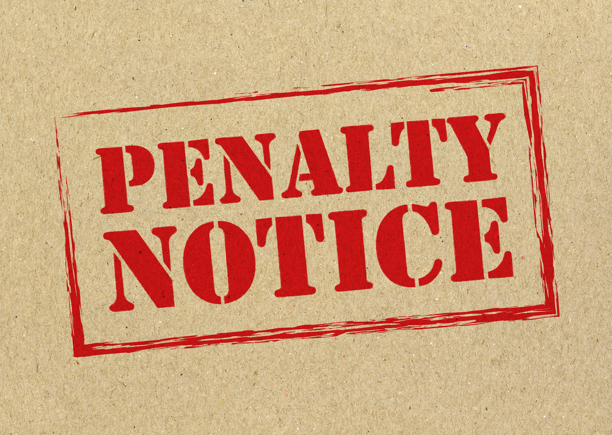
OFFENSES AND PENALTIES
CHAPTER XIII: OFFENSES AND PENALTIES (S-85 TO S-89)
PATWARDHAN LAW ASSOCIATES

Slide 53
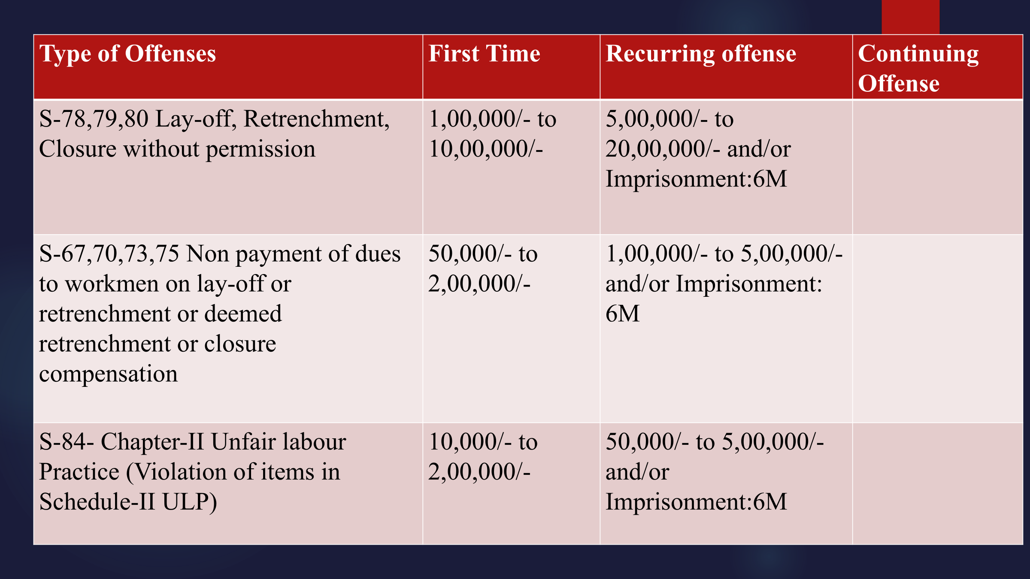

Slide 54
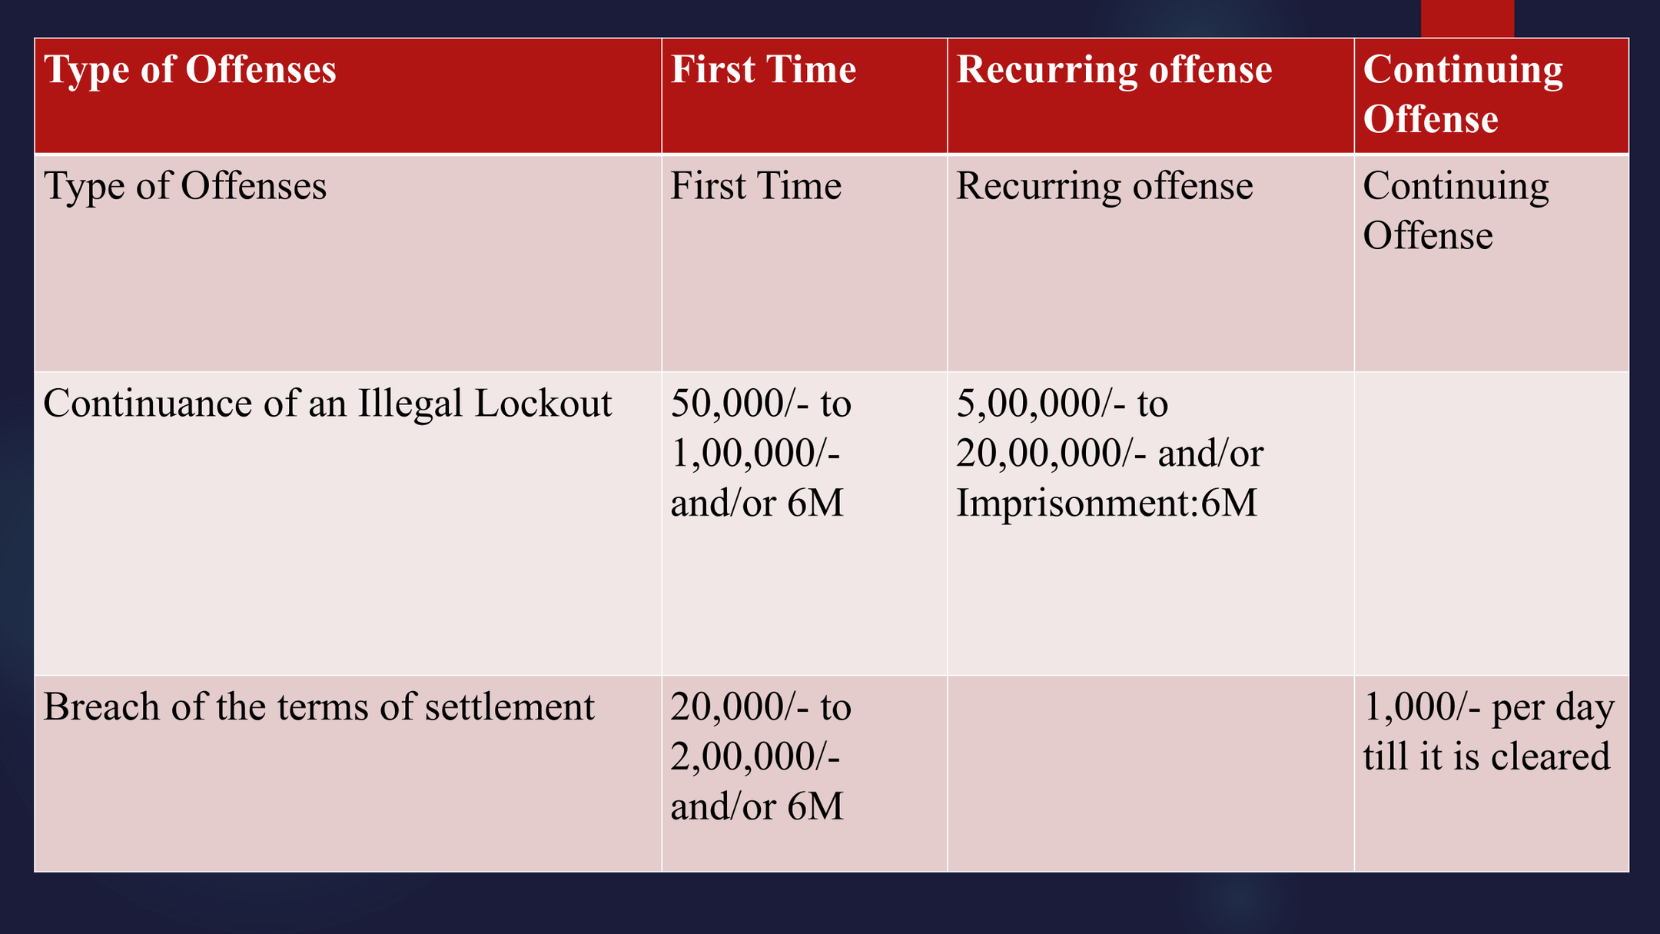

Slide 55
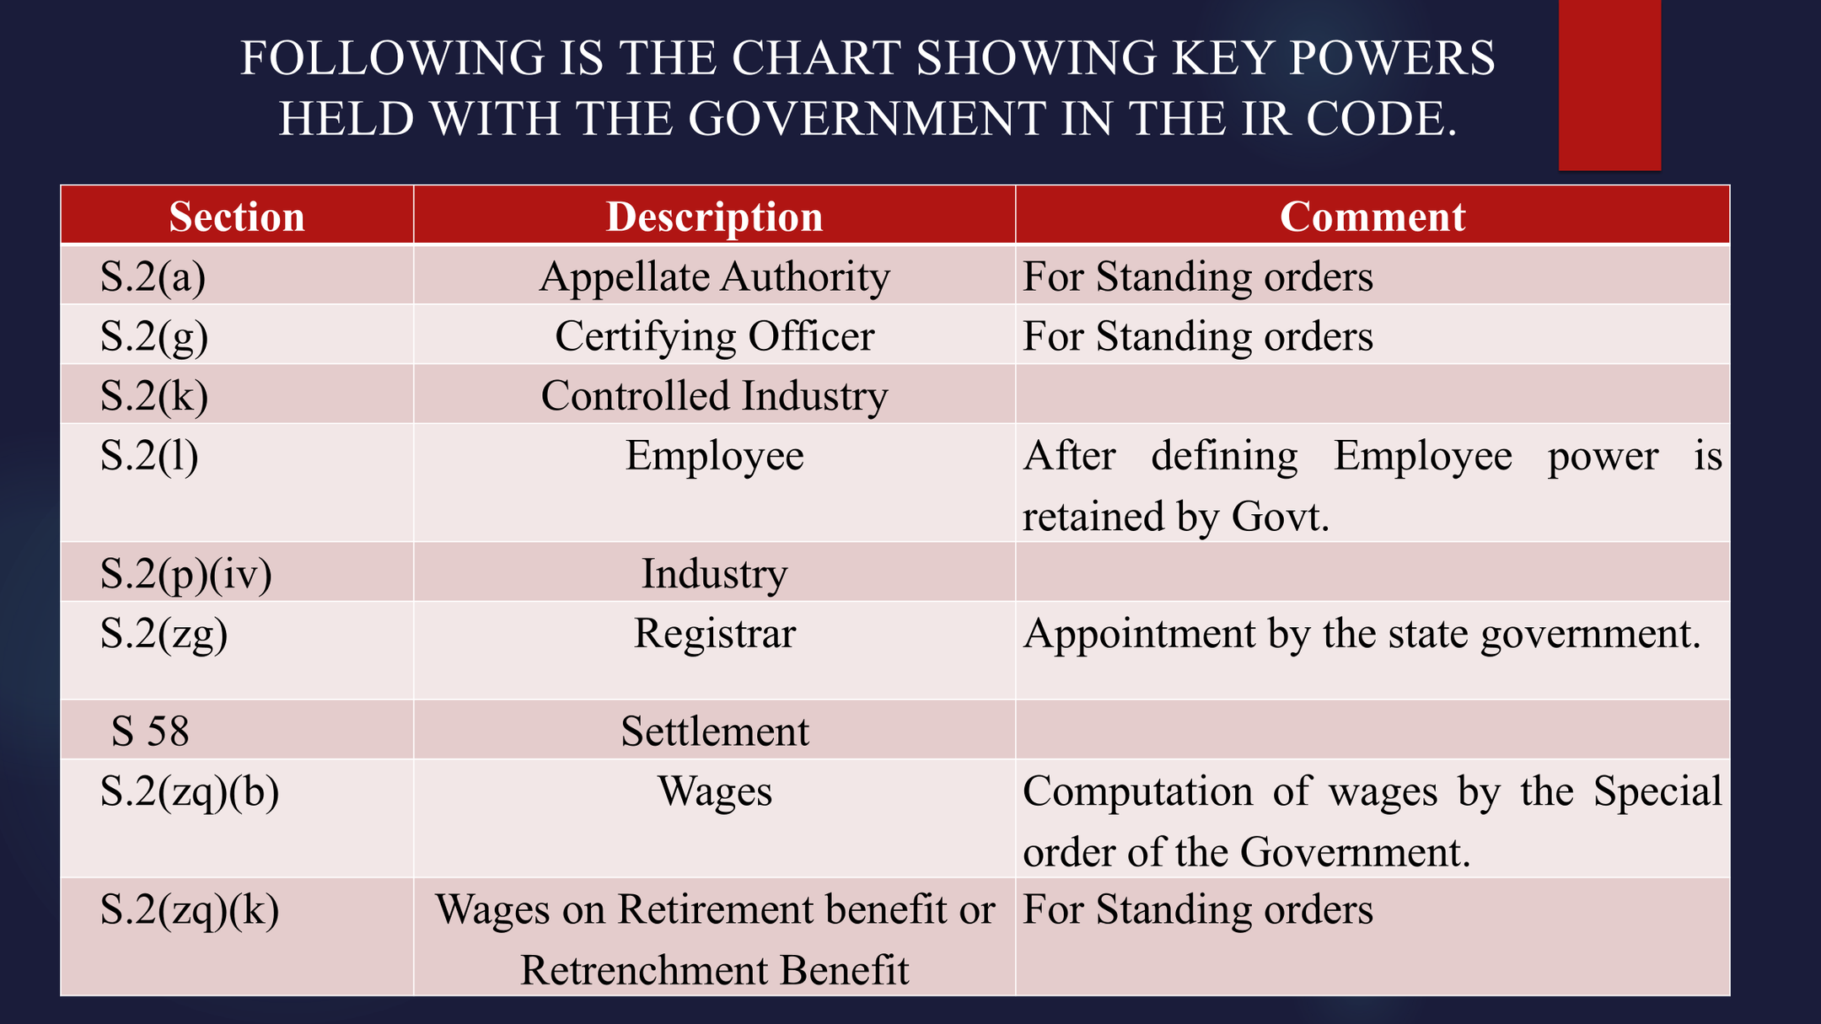

Slide 56
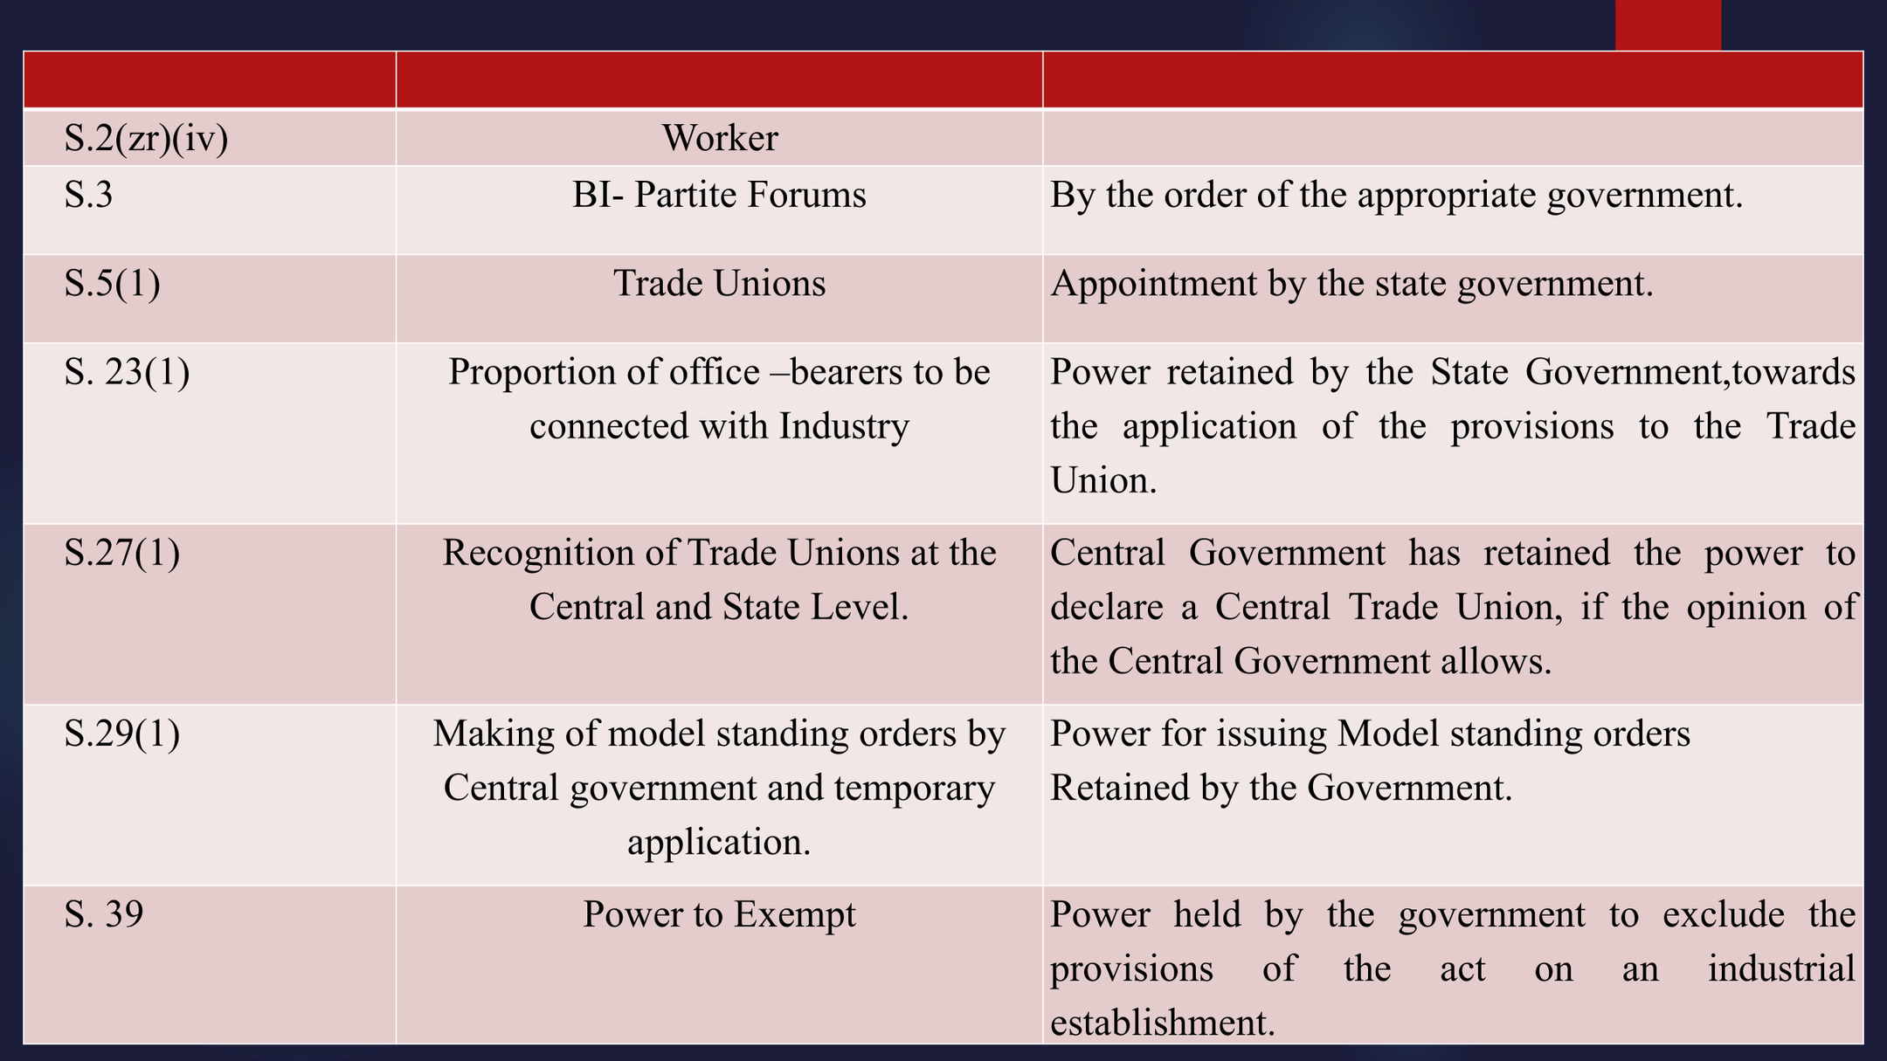

Slide 57
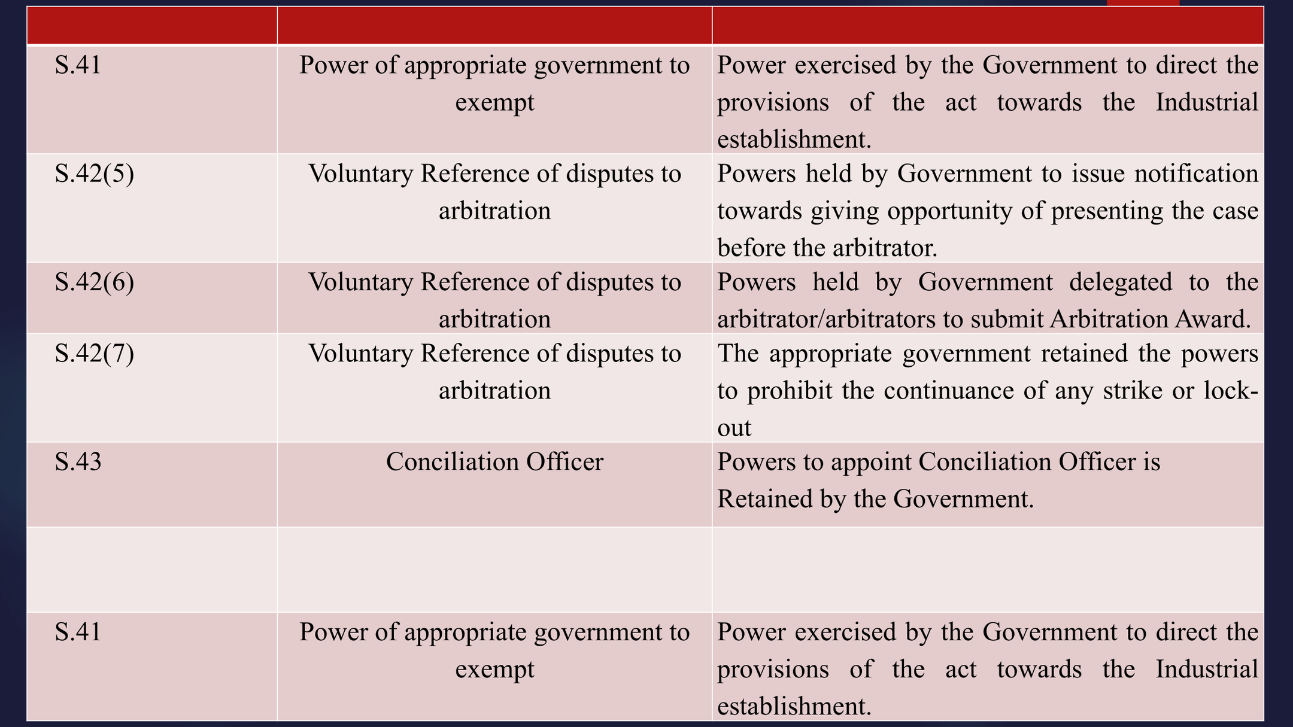

Slide 58
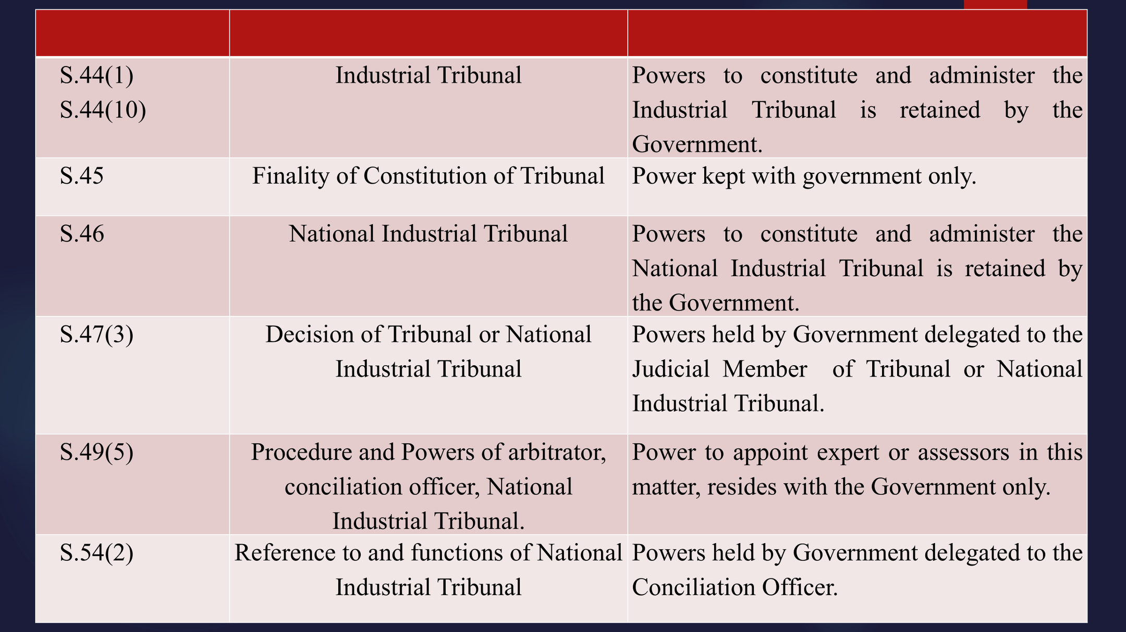

Slide 59
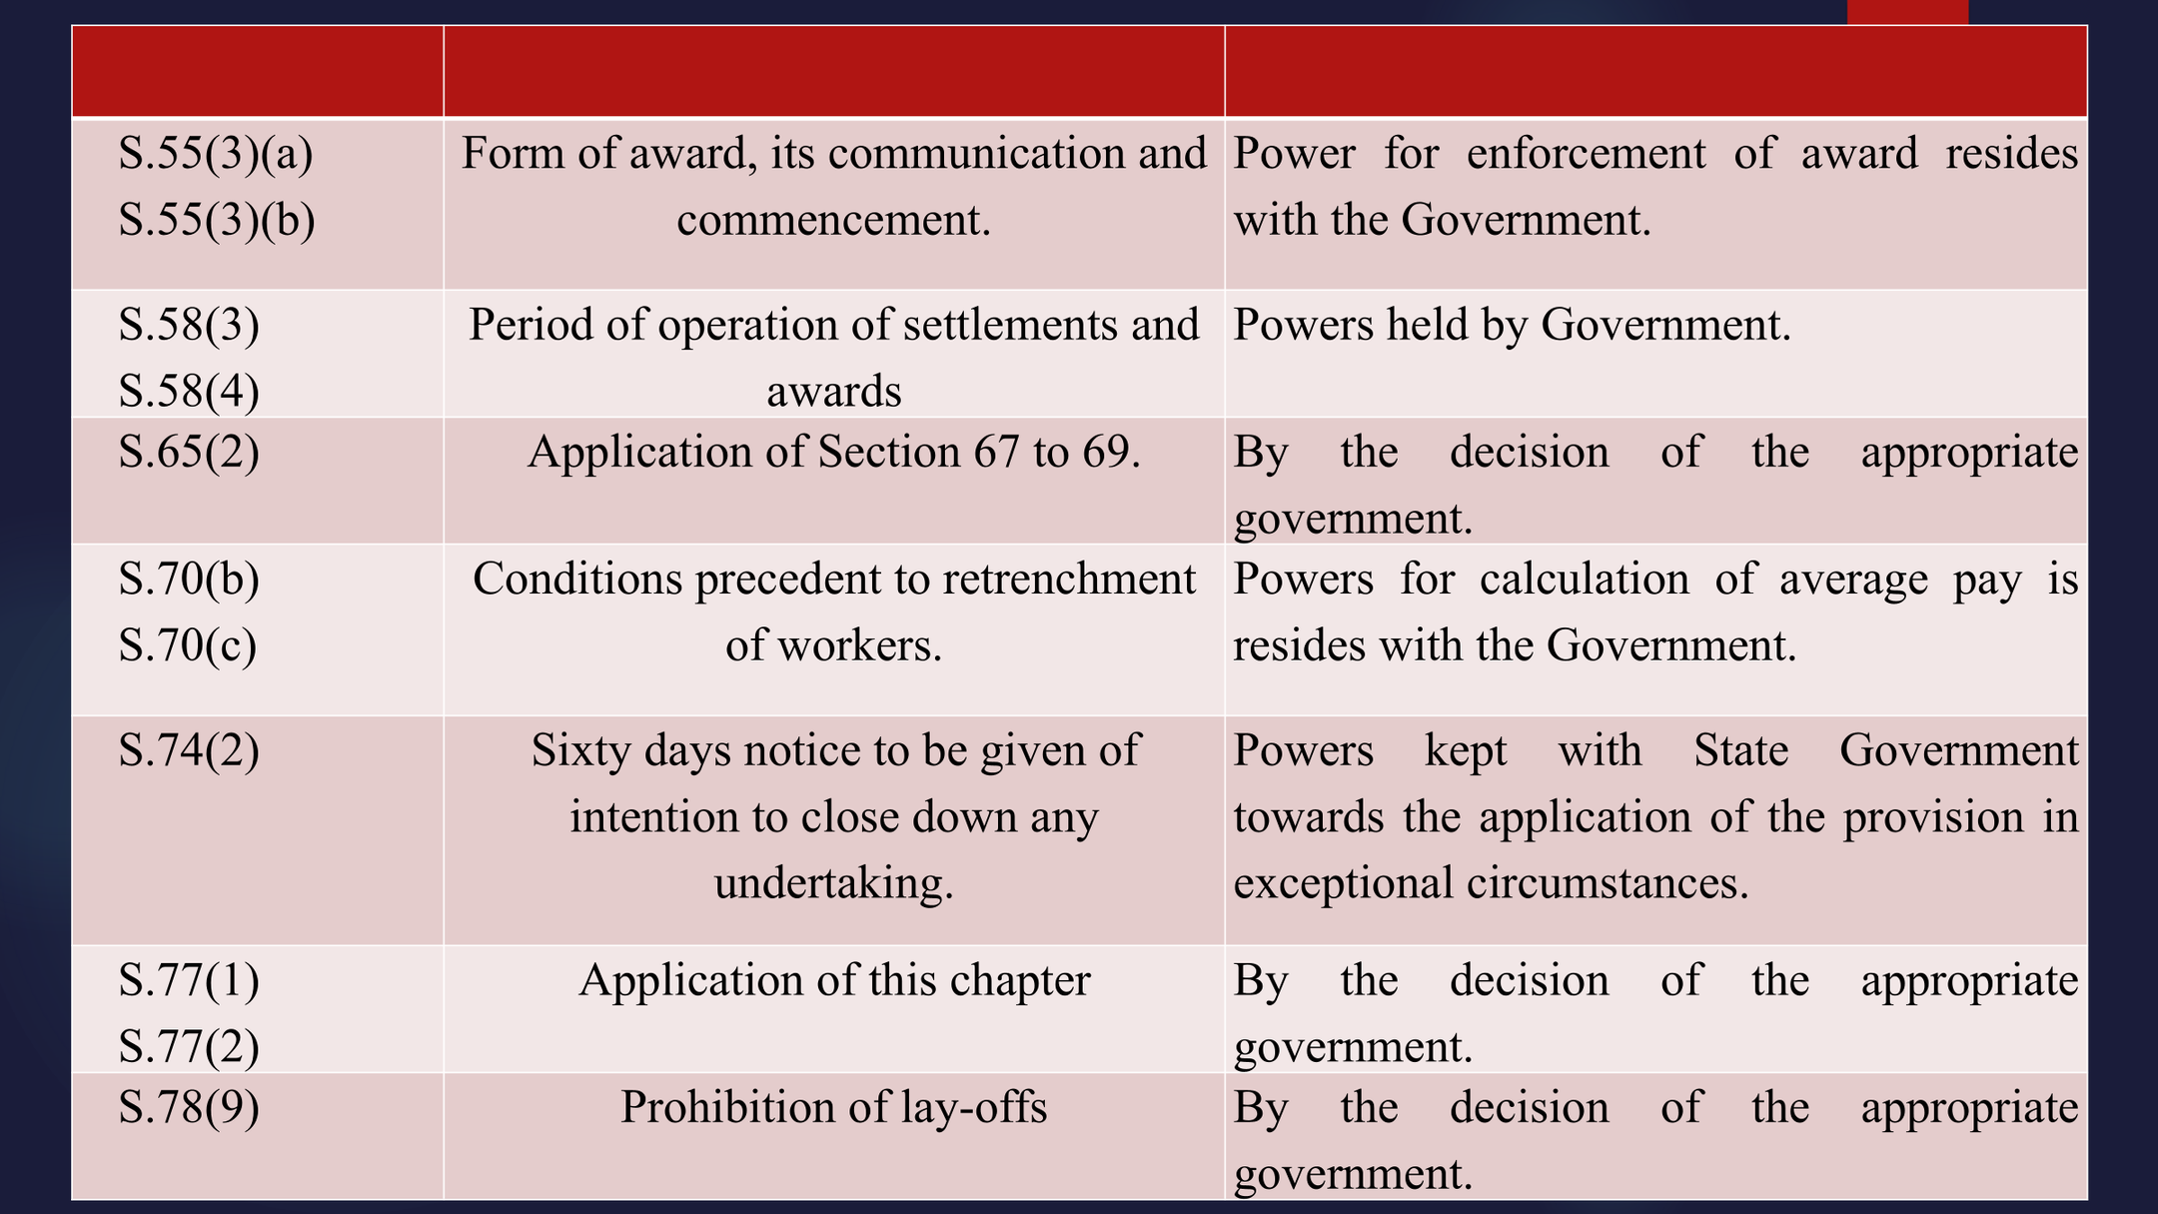

Slide 60
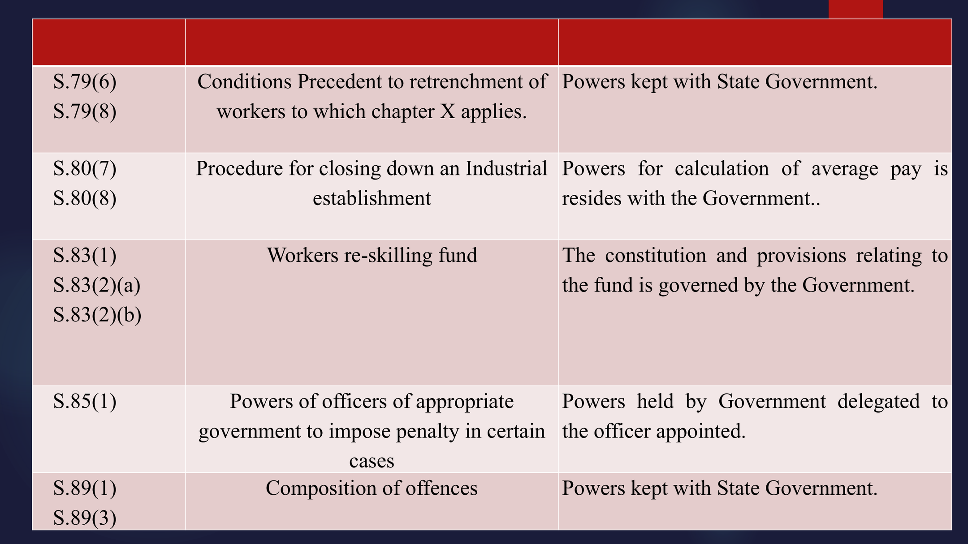

Slide 61
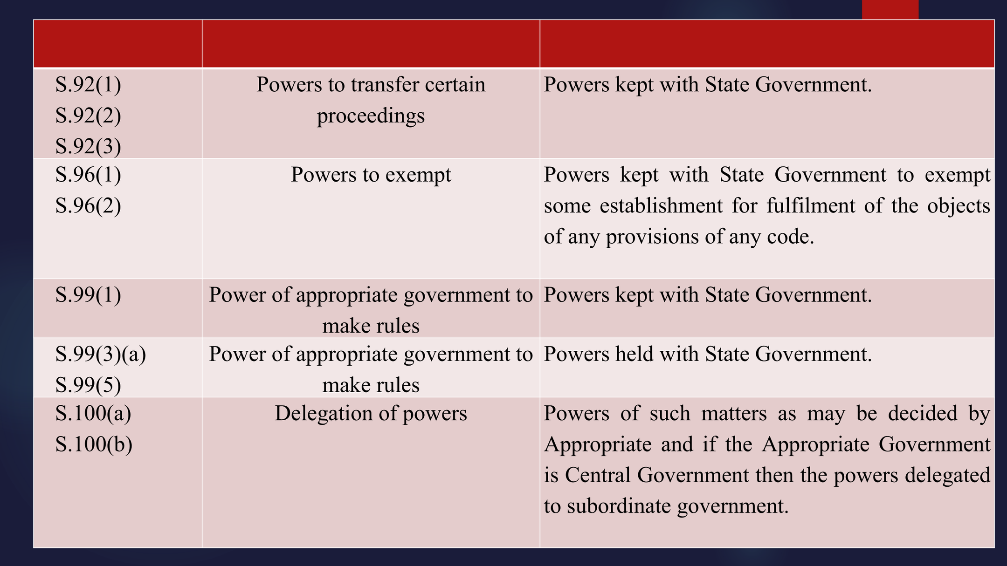

Slide 62
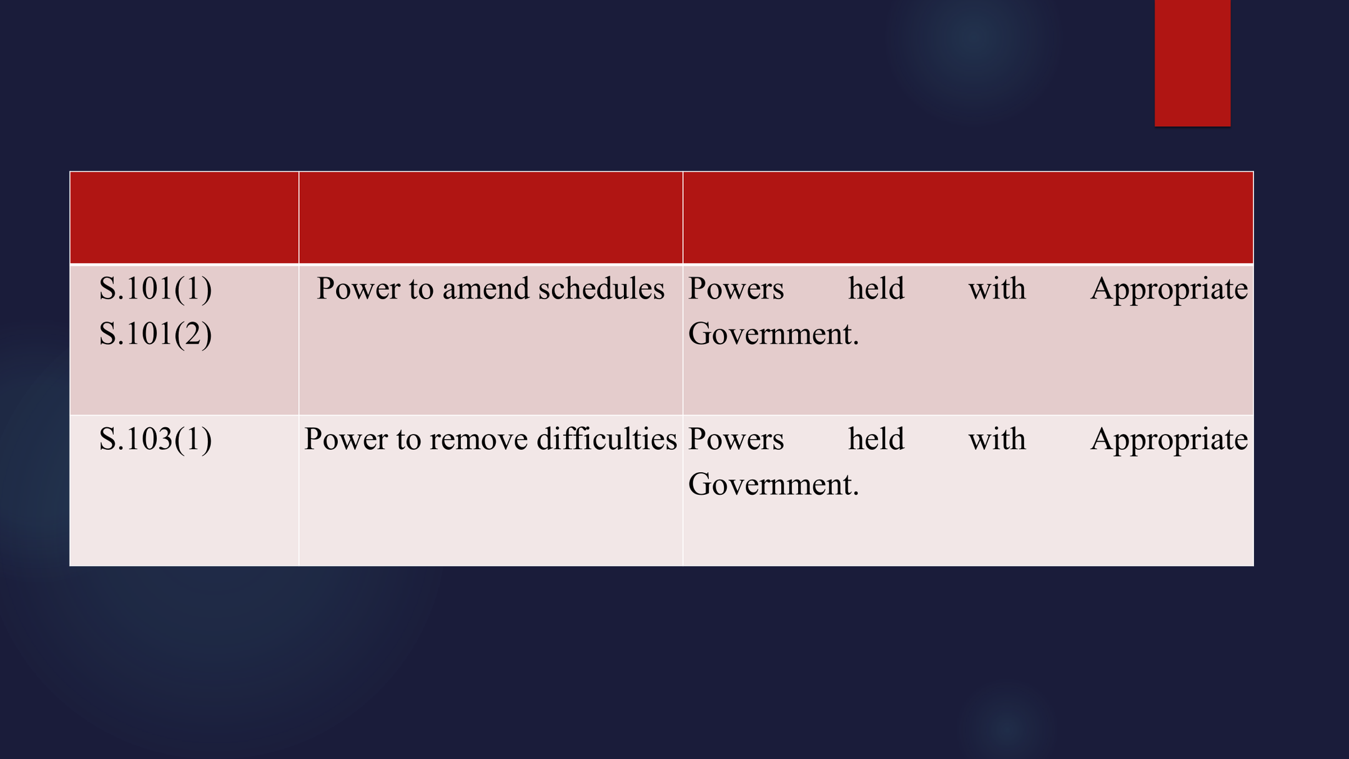

Slide 63
CONTACT FOR ANY QUERY REGARDING
THE LABOUR CODE:
E-mail ID: girish@patwardhan.in, kirti@patwardhan.in
Web page: www.girish.patwardhan.in
Mobile : 09981953534 (M),
Phone: 0731-4976193 (O),
Office Address(1): B 303-304 , Prakrati Corporate, 18/2, Y N Road, Indore.
Chamber (2): No. 46, High Court Advocates Chamber, High Court, Indore
PATWARDHAN LAW ASSOCIATES

Slide 64
THANK YOU
PATWARDHAN LAW ASSOCIATES

